Slide 1
Programming Technique and Problem Complexity - Impacts on Performance
CS531 Course Project
Jason Graalum
Portland State University
Winter 2019

Slide 2
Goal
Explore and analysis differences between= standard serial, multi-threaded, and multi-processor programming techniques to solve a common problem.
Evaluate the application of the various technique for solving a problem.

Slide 3
Experimental Setup and Methodology
Hardware Specification
6 x Raspberry Pi 3B/3B+ Cluster+
8-port Gigabit Ethernet Unmanaged Switch with LAN access
OS/Kernel
Raspbian GNU/Linux 9 (stretch)
Linux cpi4 4.14.98-v7+ #1200 SMP Tue Feb 12 20:27:48 GMT 2019 armv7l GNU/Linux
Software
(Open MPI) 4.0.0
clang version 7.0.1 (tags/RELEASE_701/final)
GNU bash, version 4.4.12(1)-release (arm-unknown-linux-gnueabihf)

Slide 4
Selected Problem Overview
Picked a standard Sudoku puzzle
Scalable – 9x9, 16x16, etc.
Problem difficulty – number of given values
Parallelizable?
Various known solutions
https://en.wikipedia.org/wiki/Sudoku_solving_algorithms
Backtracking
Exact Cover – Algorithm X
https://en.wikipedia.org/wiki/Sudoku

Slide 5
Backtrack Method
Use a recursive algorithm to find the “first” solution
Deterministic algorithm
Select the next number and validate
If valid, move to next cell and call the solve routine again
If return with success, return success
If return with failure, return with failure.
If not valid, and last number, return with a failure
Learning -> Does NOT easily lend itself to parallel solutions
Except during the validation step

Slide 6
Exact Cover
Sudoku puzzles may be described as an exact cover problem. This allows for an elegant description of the problem and an efficient solution. Modelling Sudoku as an exact cover problem and using an algorithm such as dancing links will typically solve a Sudoku in a few milliseconds.
https://en.wikipedia.org/wiki/Sudoku_solving_algorithms
In computer science, dancing links is the technique suggested by Donald Knuth to efficiently implement his Algorithm X.^{[1]} Algorithm X is a recursive, nondeterministic, depth-first, backtracking algorithm that finds all solutions to the exact cover problem. Some of the better-known exact cover problems include tiling, the n queens problem, and Sudoku.
https://en.wikipedia.org/wiki/Dancing_Links
https://en.wikipedia.org/wiki/Donald_Knuth

Slide 7
Data and Analysis
Serial Solution - Baseline
Data from each CPI machine – 1 through 6
9x9 puzzle
16x16 puzzle
Pthread Solution
Data from CPI1 running threaded code using 4 cores
9x9 puzzle
MPI Solution
Data from CPI1 running various processors
16x16 – 4 processors x 4 cores
16x16 – 4 processors x 4 cores – not using master processor
16x16 – 6 processors x 3 cores

Slide 8
Serial Data – Min/Max/Ave/StdDev

Slide 9
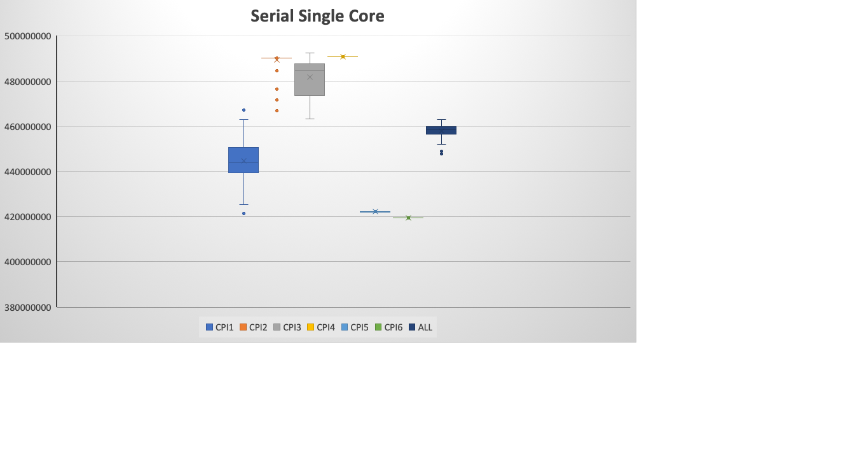
Serial Solution Data – 9x9 Puzzle
CPI2-4
All CPIs
CPI1
CPI5/CPI6

Slide 10
Serial Analysis – Hardware Insight
CPI 1
Middle performance
Newer Raspberry Pi – is faster than CPI 2, 3, and 4
Mount server – assumption is that being the ”file server” impact performance
CPI 5 and 6
Best performance
Newest Raspberry Pi’s – obviously faster even though no difference in hardware version or installed software
CPI 2, 3
Older hardware, but still same version
Unclear why they are slower
CPI 4
Older hardware version which has a slower maximum clock rate and slower network
1200MHz vs. 1400MHz maximum clock rate
100M vs 1G Ethernet

Slide 11
Network Impact
 |  | Source Node
Destination Node |  | 1 | 2 | 3 | 4 | 5 | 6 | Dst Avg
 | 1 |  | 2.030 | 3.067 | 3.530 | 1.889 | 1.663 | 2.436
 | 2 | 1.807 |  | 3.071 | 3.217 | 1.844 | 1.957 | 2.379
 | 3 | 2.917 | 3.170 |  | 3.431 | 2.304 | 2.743 | 2.913
 | 4 | 3.680 | 3.320 | 3.221 |  | 3.510 | 3.556 | 3.457
 | 5 | 2.439 | 1.994 | 1.940 | 3.687 |  | 1.829 | 2.378
 | 6 | 2.093 | 2.100 | 2.236 | 3.586 | 1.687 |  | 2.340
 | Src Avg | 2.587 | 2.523 | 2.707 | 3.490 | 2.247 | 2.349
Sample Command: /usr/bin/time --format "3 1 %e" scp file.txt pi@cpi1:/home/pi/

Slide 12
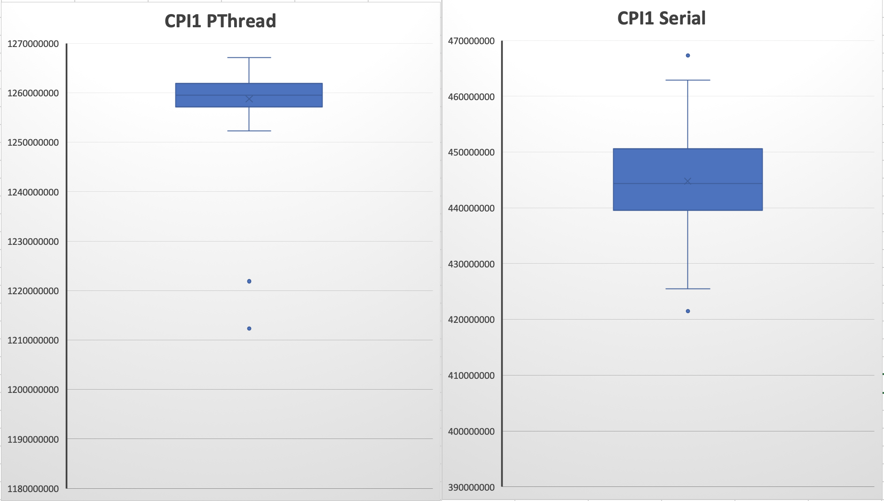
Multi Threaded – 4 cores – 9x9 Puzzle
Threads were used to parallelize the parts of the validation routine
Validate Rows, Columns and Blocks within a puzzle
Use three threads – one for each type of validation
9x9 Problem is relatively small
Overhead of creating the threads swamps out any parallel advantage.
No addition effort was spent looking at Threading
Focus shifted to Multi-Processing

Slide 13
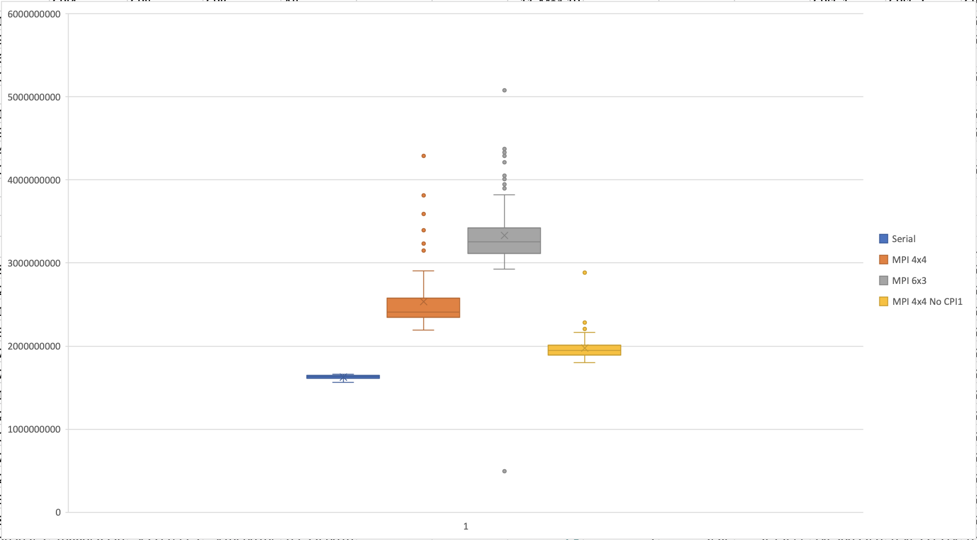
MPI Variations Data

Slide 14
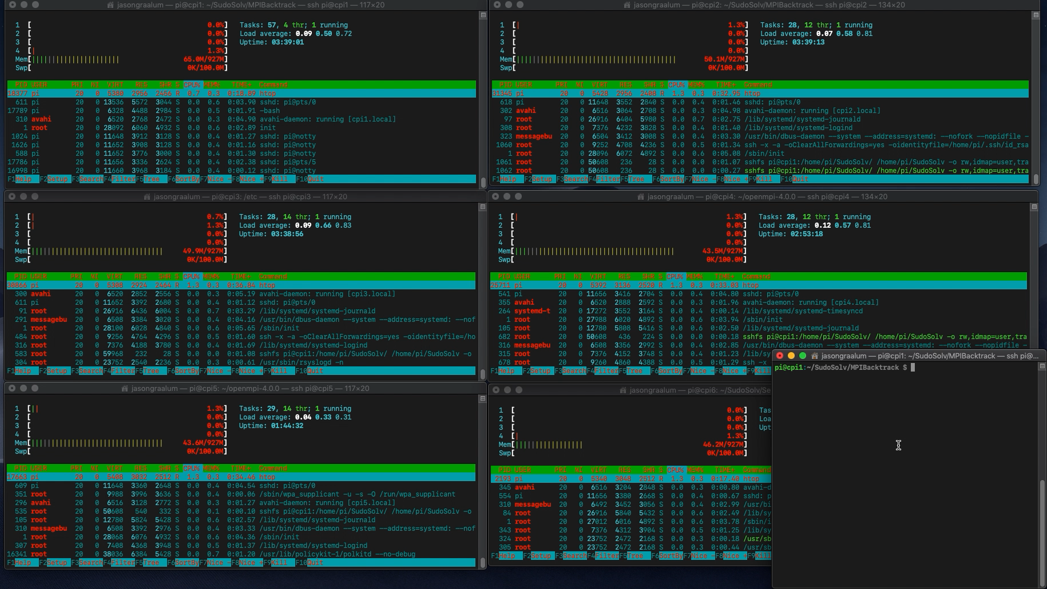
MPI - Video

Slide 15
Conclusion
Overhead overshadows benefits from the multiple threads or processors
Hidden hardware differences impact relative performance
Network traffic patterns impact performance
Serving the program via sshfs mounts
Reserving a processor as the master improves performance
Problem size needs to be large enough to account for parallel solution overhead

Slide 16
Back Up

Slide 17
Other Impacts to Relative Performance
Networking Noise
All nodes used a mount to CPI1 for the applications
The additional network requirements and periodic conflicts probably impacted the measurements
Possible follow-on investigation
Different Hardware Performance
Even though all CPIs except CPI4 have the same specs there are clear performance differences.
Possible follow-on investigation

Slide 18
Hardware Cluster Details
Mod | CPI1 | CPI2 | CPI3 | CPI4 | CPI5 | CPI6
Model Name | Raspberry Pi 3 Model B Plus Rev 1.3 | Raspberry Pi 3 Model B Plus Rev 1.3 | Raspberry Pi 3 Model B Plus Rev 1.3 | Raspberry Pi 3 Model B Plus Rev 1.2 | Raspberry Pi 3 Model B Plus Rev 1.3 | Raspberry Pi 3 Model B Plus Rev 1.3
Hardware | BCM2835 | BCM2835 | BCM2835 | BCM2835 | BCM2835 | BCM2835
Revision | a020d3 | a020d3 | a020d3 | a02082 | a020d3 | a020d3
Serial No | 000000005b4da04e | 000000008b55fda7 | 0000000090e9c1b9 | 00000000f0cdcb24 | 00000000f0cdcb24 | 00000000795eff10
Architecture | armv7l | armv7l | armv7l | armv7l | armv7l | armv7l
Byte Order | Little Endian | Little Endian | Little Endian | Little Endian | Little Endian | Little Endian
CPU(s) | 4 | 4 | 4 | 4 | 4 | 4
On-line CPU(s) list | 0-3 | 0-3 | 0-3 | 0-3 | 0-3 | 0-3
Thread(s) per core | 1 | 1 | 1 | 1 | 1 | 1
Core(s) per socket | 4 | 4 | 4 | 4 | 4 | 4
Socket(s) | 1 | 1 | 1 | 1 | 1 | 1
Model | 4 | 4 | 4 | 4 | 4 | 4
Model name | ARMv7 Processor rev 4 (v7l) | ARMv7 Processor rev 4 (v7l) | ARMv7 Processor rev 4 (v7l) | ARMv7 Processor rev 4 (v7l) | ARMv7 Processor rev 4 (v7l) | ARMv7 Processor rev 4 (v7l)
CPU max MHz | 1400.0000 | 1400.0000 | 1400.0000 | 1200.0000 | 1400.0000 | 1400.0000
CPU min MHz | 600.0000 | 600.0000 | 600.0000 | 600.0000 | 600.0000 | 600.0000
BogoMIPS | 38.40 | 38.40 | 38.40 | 38.40 | 38.40 | 38.40

Slide 19
Serial Analysis – Data Distribution
CPI 1, 2, 3 – high standard deviation
CPI 4, 5, 6 – low standard deviation
Higher performance CPI5 and CPI6

